Slide 1
Software Architecture
Principles of Package Design

Slide 2
Packages Introduction
What is a package?
  Classes are not sufficient to group code
  Some classes collaborate dependencies
  Some don't know each other
Grouping related classes together seems natural
  But how?
  Dependencies between packages
Software Systems Architecture
Xiaobin Xu
2

Slide 3
Six Design Principles
Principles of package cohesion
  The Reuse-Release Equivalence Principle
  The Common-Reuse Principle
  The Common-Closure Principle
Govern the partitioning of classes into packages
Software Systems Architecture
Xiaobin Xu
3

Slide 4
Six Design Principles
Principles of package coupling
  The Acyclic-Dependencies Principle
  The Stable-Dependencies Principle
  The Stable-Abstractions Principle Govern the interrelationships between
packages.
Software Systems Architecture
Xiaobin Xu
4

Slide 5
The Reuse-Release Equivalence Principle
REP:
  the granule of reuse is the granule of release.
Software Systems Architecture
Xiaobin Xu
5

Slide 6
The Common-Reuse Principle
CRP:
  The classes in a package are reused together. If you reuse one of the classes in a package, you reuse them all.
In such a package, classes have lots of dependencies on each other.
Classes are not tightly bound to each other with class relationships should not be in the same package.
Software Systems Architecture Xiaobin Xu 6

Slide 7
The Common-Closure Principle
CCP:
  The classes in a package should be closed together against the same kinds of changes. A change that affects a package affects all the classes in that package and no other packages.
A package should not have multiple reasons to change.
Software Systems Architecture
Xiaobin Xu
7

Slide 8
The Acyclic-Dependencies Principle
ADP:
  Allow no cycles in the package- dependency graph
Morning-after syndrome
Two solutions:
  The weekly build
  ADP
Software Systems Architecture
Xiaobin Xu
8

Slide 9
The Weekly Build
All the developers ignore each other for the first four days of the week. They all work on private copies of the code and don’t worry about integrating with each other.
On Friday, they integrate all their changes and build the system.
Common in medium-sized projects
Software Systems Architecture
Xiaobin Xu
9

Slide 10
Eliminating Dependency
Cycles
Partition the development environment into releasable packages.
To make it work, there can be no cycles.
Regardless of the package at which you begin, it is impossible to follow the dependency relationship and wind up back at that package. This structure has no cycles. It is a directed acyclic graph (DAG).
Software Systems Architecture
Xiaobin Xu
10

Slide 11
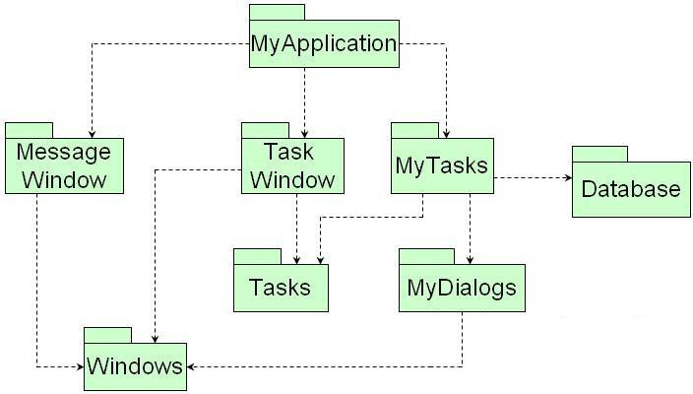
Directed Acyclic Graph (DAG)
Software Systems Architecture
Xiaobin Xu
11

Slide 12
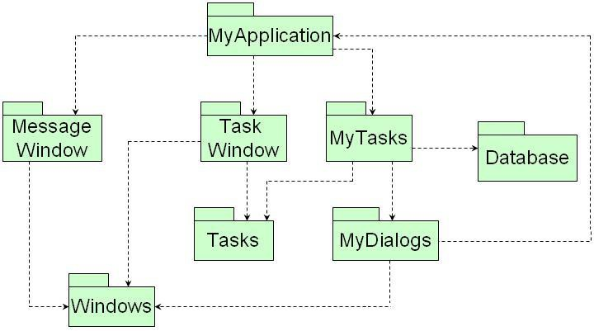
The effect of a Cycle in the
Package Dependency Graph
Software Systems Architecture
Xiaobin Xu
12

Slide 13
Breaking the Cycle
Two mechanisms to break a cycle of packages and reinstate the dependency graph as a DAG.
  Apply the Dependency-Inversion Principle
  Create a new package on which both MyDialog and MyApplication depend.
Software Systems Architecture
Xiaobin Xu
13

Slide 14
Breaking the cycle with
dependency inversion
MyDialogs
MyApplication
X
Y
MyDialogs
MyApplication
X
<<interface>> X Server
Y
Software Systems Architecture
Xiaobin Xu
14

Slide 15
Breaking the cycle with a new package
MyApplication
Message Window
Task Window
MyTasks
Database
Tasks
MyDialogs
Windows
aNewPackage
Software Systems Architecture
Xiaobin Xu
15

Slide 16
Top-Down Design
The package structure cannot be designed from the top down.
  Not one of the first things about the system that is designed.
  Evolve as the system grows and changes
Package dependency diagrams are a map to the buildability of the application.
It will fail to design the package dependency
structure before designing any classes.
Software Systems Architecture Xiaobin Xu
16

Slide 17
The Stable-Dependencies Principle
SDP:
  Depend in the direction of stability.
Conforming to the SDP can ensure that modules that are intended to be easy to change are not depended on by modules that are harder to change than they are.
Software Systems Architecture
Xiaobin Xu
17

Slide 18
Stable package
Stable package
  Responsible: three packages depends on x.
  Independent: x depends on nothing.
X
Software Systems Architecture
Xiaobin Xu
18

Slide 19
Instable package
Instable package
  Irresponsible: Y has no other packages depending on it.
  Dependent: change may come from external sources
●
Y
Software Systems Architecture
Xiaobin Xu
19

Slide 20
Stability Metrics
Stability Metrics
I =
Ca :Afferent Couplings
Ce
Ca + Ce
The number of classes outside this package that
_{C}depend on classes within this package
●
e
:Efferent Couplings
The number of classes inside this package that depend on classes outside this package.
I: Instability
  I=0 indicates a maximally stable package
  I=1 indicates a maximally instable package
Software Systems Architecture Xiaobin Xu
20

Slide 21
Stability Metrics
Ca = 3
Ce =1
Pa
Pb
Q R
S
1
4
I =
Pc
Pd
T U
V
Software Systems Architecture
Xiaobin Xu
21

Slide 22
Stability Metrics
SDP says that the I metrics of a package should be larger than the I metrics of the packages that it depend on (i.e., I metrics should decrease in the direction of dependency)
Software Systems Architecture
Xiaobin Xu
22

Slide 23
Not All Package Should Be Stable
The changeable packages are on top and depend on the stable package at the bottom.
S
U
F
C
S
U
Stable
F
Flexible
I
C
Software Systems Architecture
Xiaobin Xu
23

Slide 24
The Stable-Abstractions Principle
SAP principle:
  A package should be as abstract as it is stable.
A stable package should also be abstract so that its stability does not prevent it from being extended.
The SAP and the SDP combined amount
to the DIP for packages.
Software Systems Architecture
Xiaobin Xu
24

Slide 25
Measuring Abstraction
Measuring Abstraction
_{A =} Na
Nc
: The number of classes in the package.
: The number of abstract classes in the
Nc
Na
package
A: Abstractness
Software Systems Architecture
Xiaobin Xu
25

